Slide 2
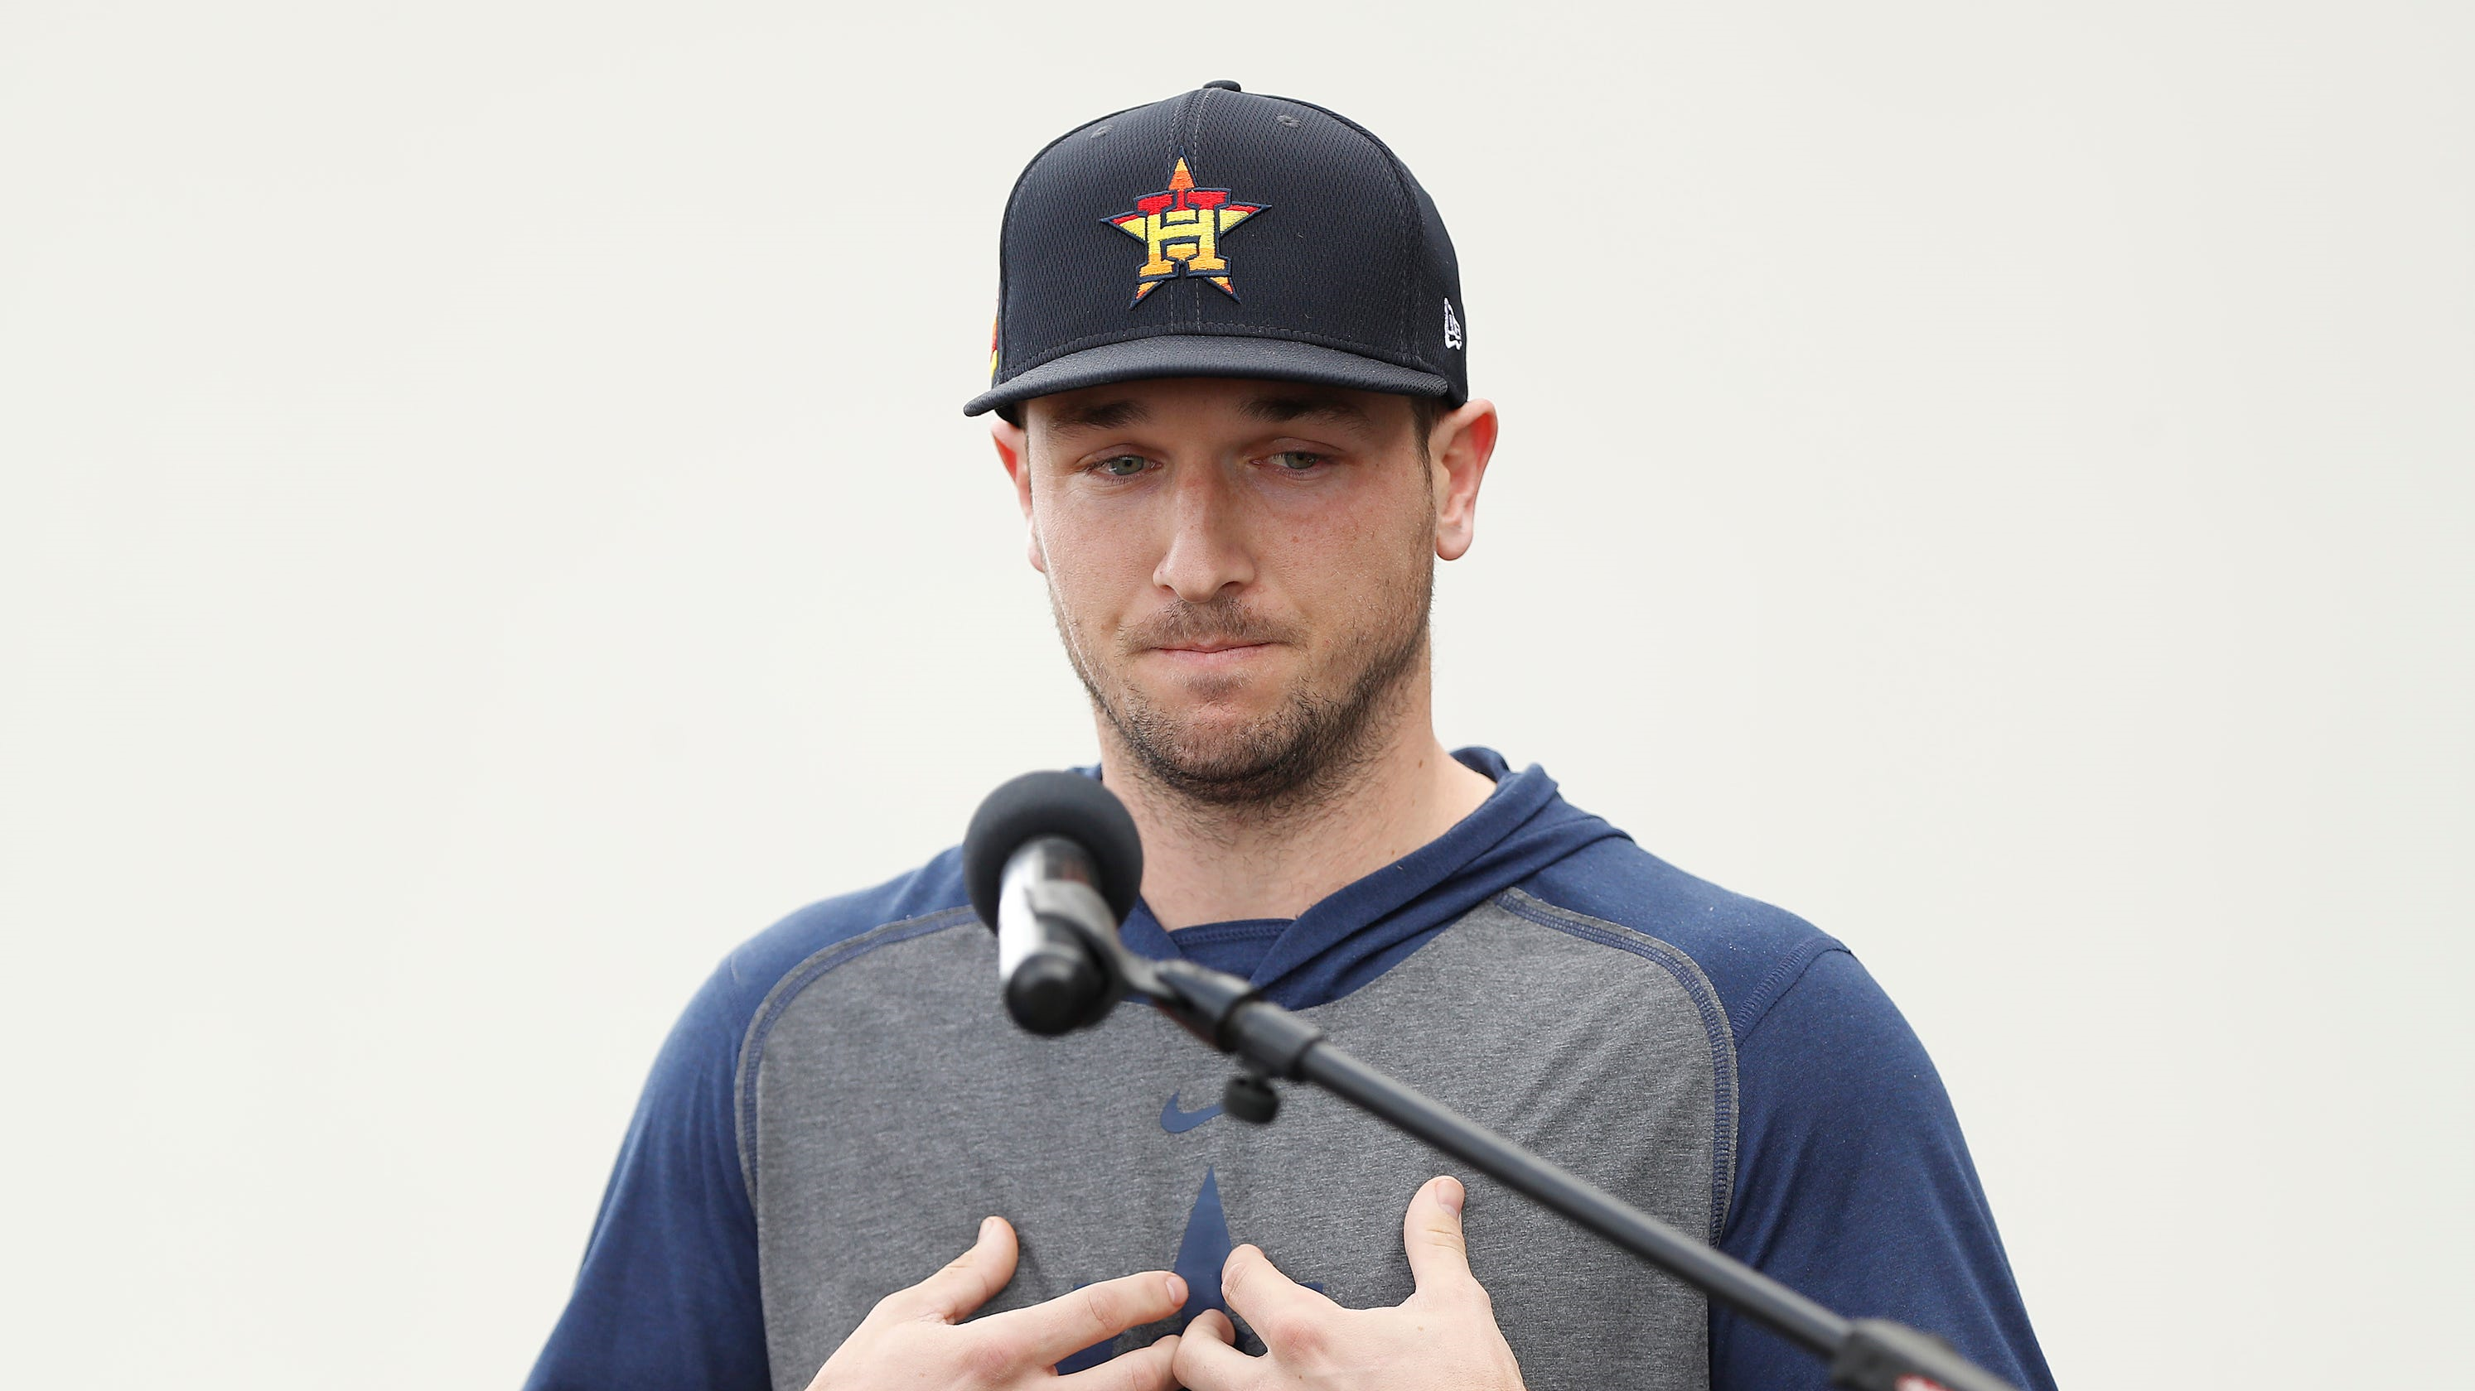

Slide 3

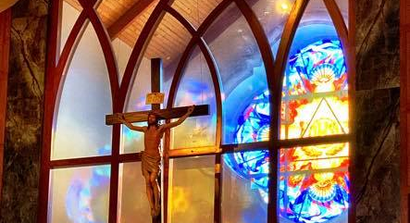

Slide 4


Slide 5


Slide 6
S haring
I s c aring

Slide 7
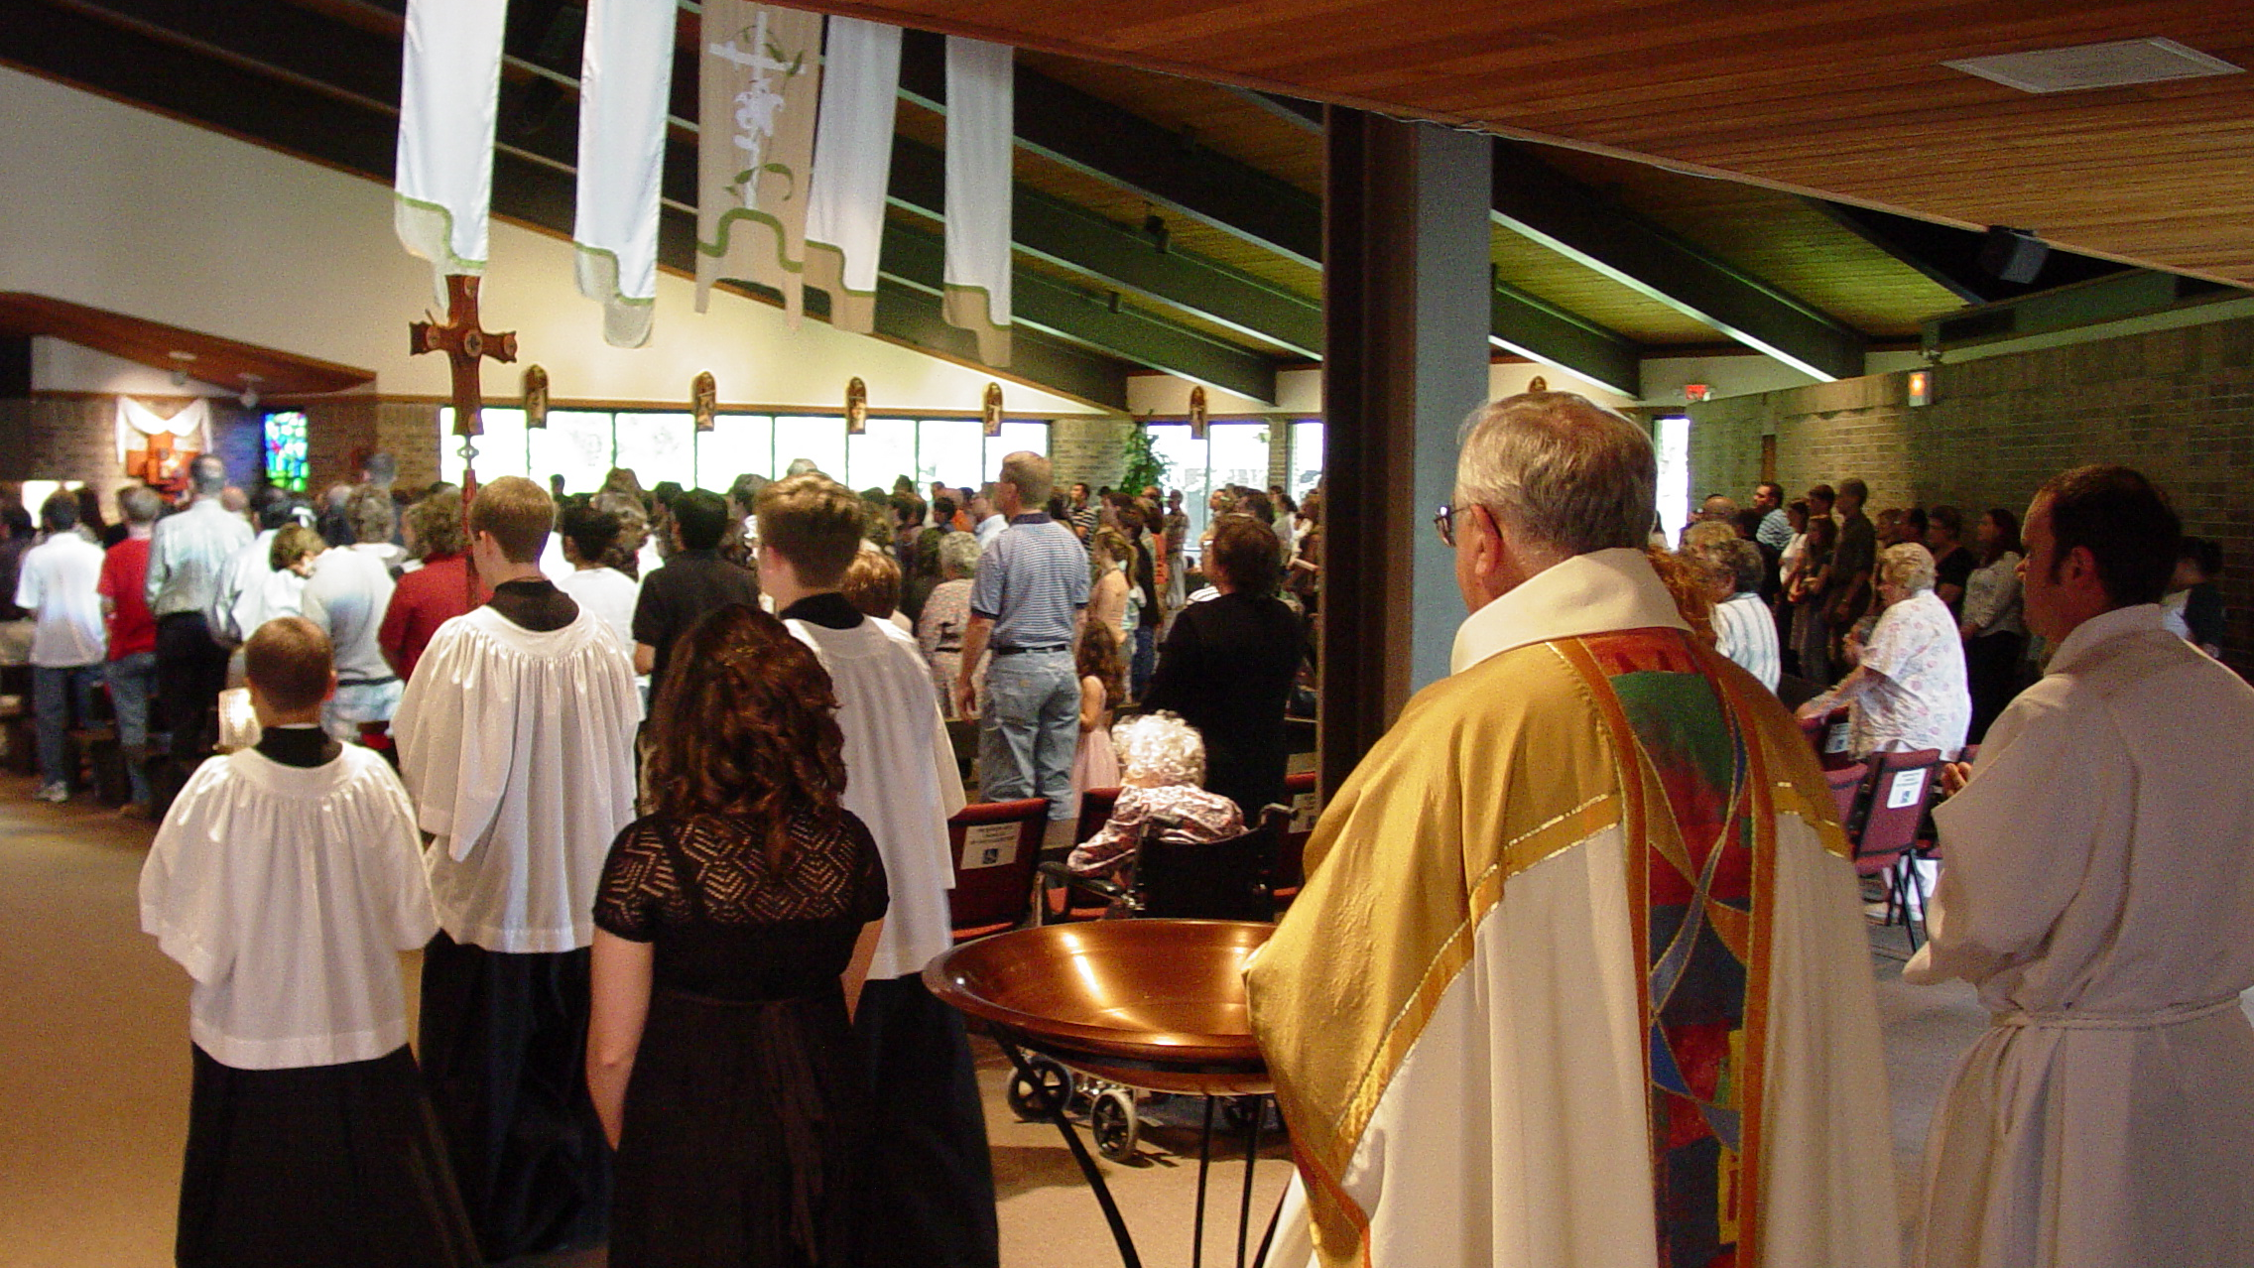

Slide 8
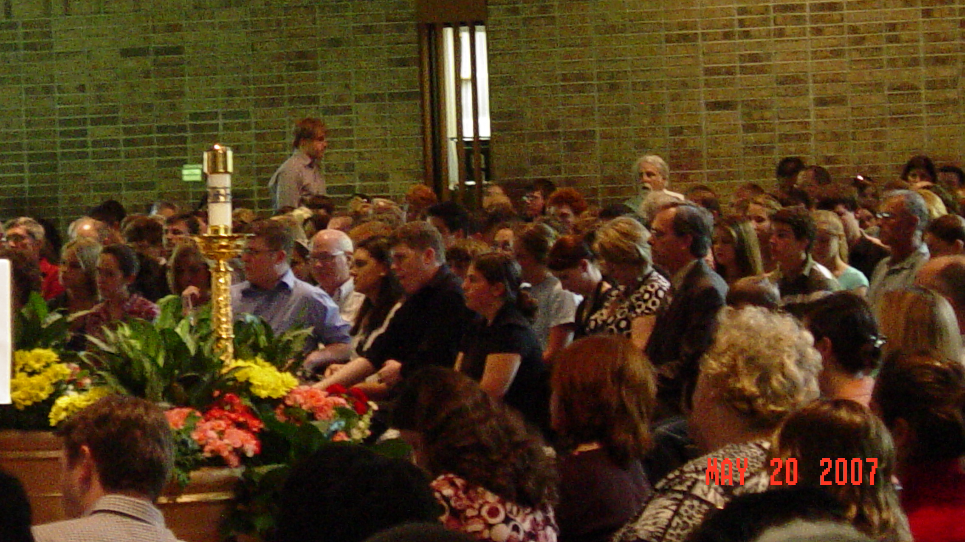

Slide 9
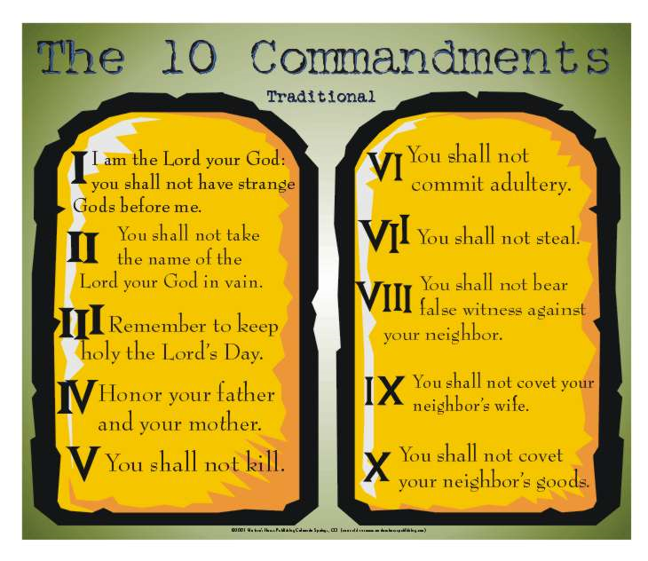

Slide 10
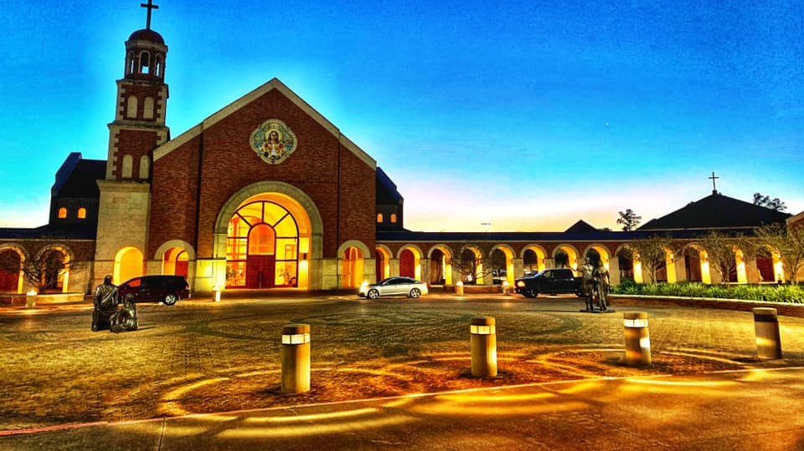

Slide 11


Slide 12
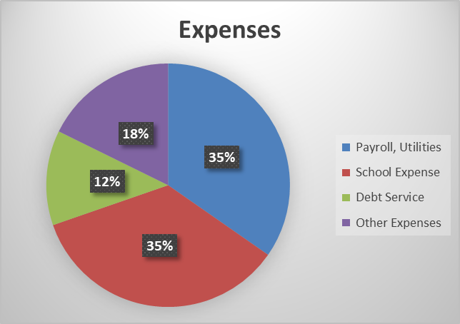

Slide 13
New Capital campaign
Everyone will get a letter
Some of you will be contacted
Please be generous!

Slide 14
The Goals
Pay off the debt (~$7.5 mill)
Contribute to Ignite ($2.3 mill)

Slide 15
Good News
We have ~ $2 million in the bank
Campaign team already at work
Already have pledges!

Slide 16
PLedges
92 donors $824,238

Slide 17
That means:
1.2% of our parishioners have pledged 10.6% of our goal!

Slide 18


Slide 20
Theme of Campaign is…
S haring
I s
C aring

Slide 21
S “Eye” C guy

Slide 22
