Slide 2


Slide 3
Football National Championships in the last 15 years
SEC- 9
ACC -3
Big 10- 1
Pac 10-1
Big 12- 1

Slide 4
NCAA players in the NFL
SEC- 339
Big 10 -253
ACC - 215
Pac 10- 189
Big 12- 122

Slide 5
SEC BY WINNING %
66.8% (vs. ACC)
63.0% (vs. Pac-12)
59.3% (vs. Big Ten)
55.3% (vs. Big 12)

Slide 6
AP Poll: Top 10 for Week 5
September 22, 2019
RANK | NAME | RECORD | Conference
1 | Clemson (55) | 4-0 | ACC
2 | Alabama (6) | 4-0 | SEC
3 | Georgia (1) | 4-0 | SEC
4 | LSU | 4-0 | SEC
5 | Ohio State | 4-0 | Big 10
6 | Oklahoma | 3-0 | Big 12
7 | Auburn | 4-0 | SEC
8 | Wisconsin | 3-0 | Big 10
9 | Florida | 4-0 | SEC
10 | Notre Dame | 2-1 | Ind

Slide 7
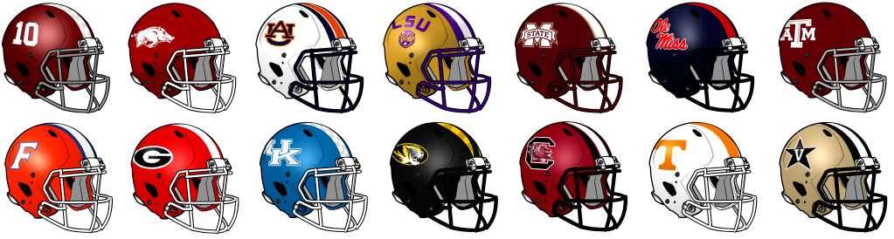

Slide 8


Slide 9
S haring
I s c aring

Slide 10
S “Eye” C

Slide 11
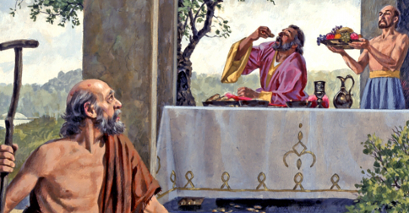

Slide 12
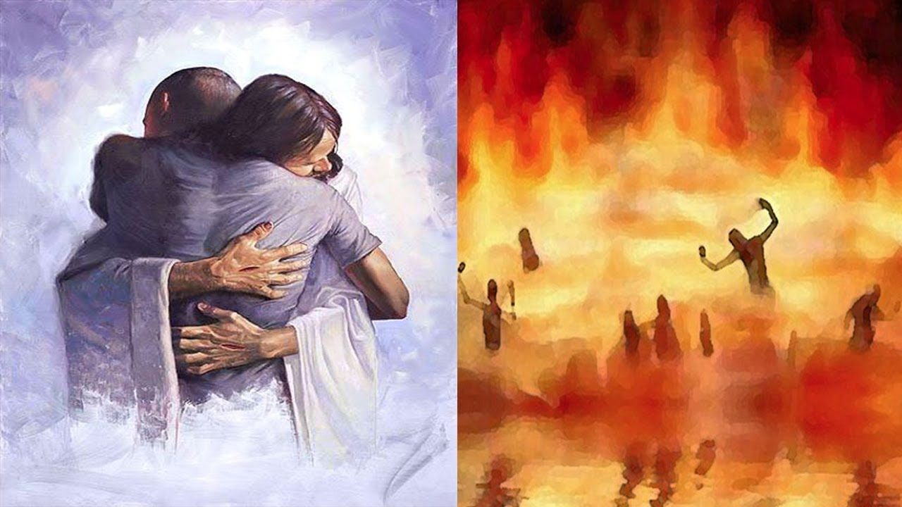

Slide 13


Slide 14


Slide 15


Slide 16


Slide 17
Budget REPORT
Can be found in the Bulletin

Slide 18
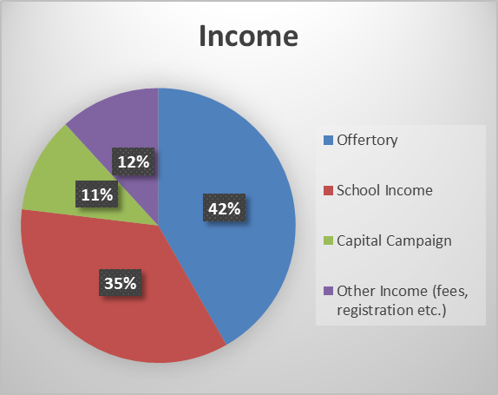

Slide 19
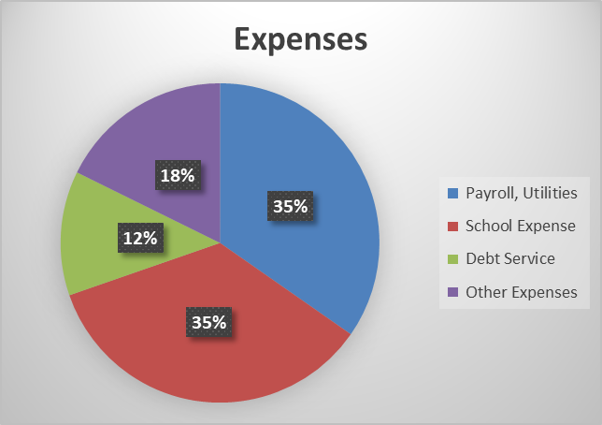

Slide 20
Increased expenses
Cost of medical insurance increased, property Insurance increased, & Maintenance projects were higher
School flooding twice is expensive
Capital Campaign Ended, But…

Slide 21
New Capital campaign
Surveys in the mail/online
Meetings with Steier group
Please help us by participating

Slide 22
The Goals
Pay off the debt
Contribute to Ignite
Upgrade the school for flooding

Slide 23
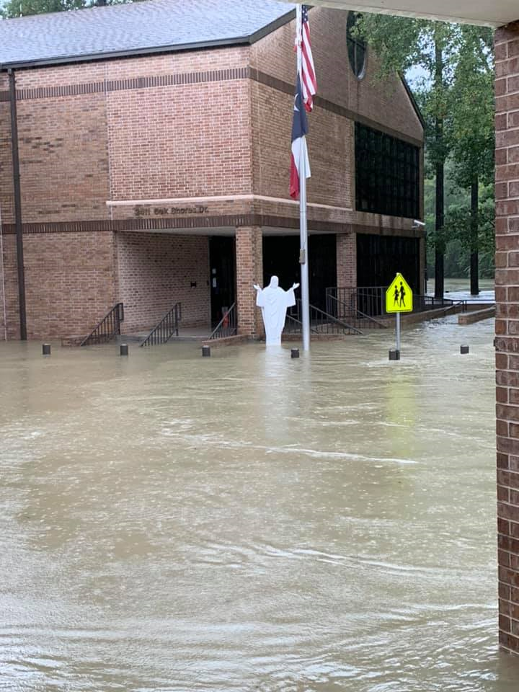

Slide 24
PARISH UPDATES
(Good News)

Slide 25
New
CHapel

Slide 26
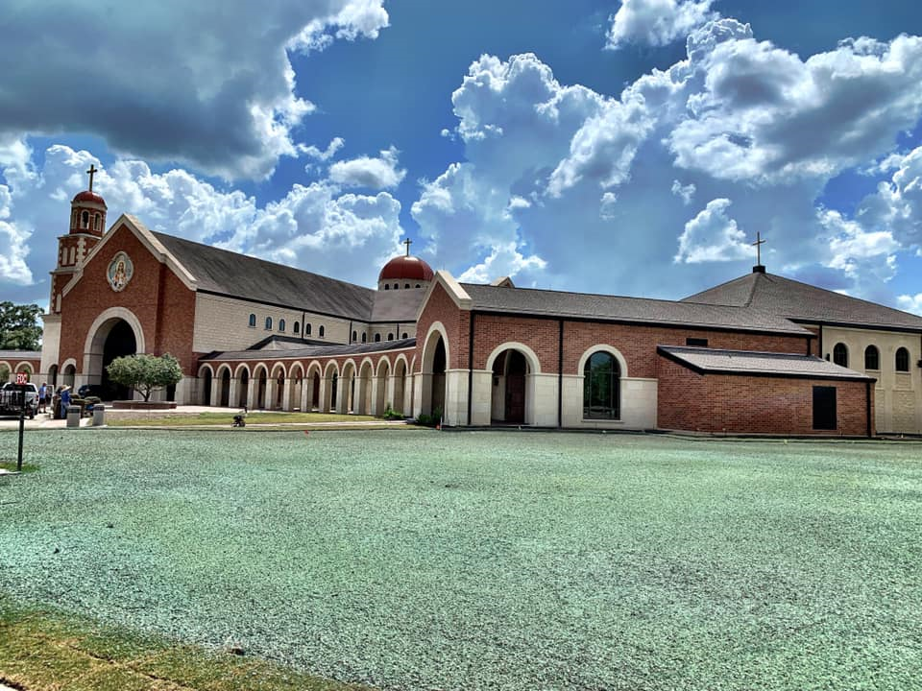

Slide 27
DEDICATION Party
Saturday, October 19th after Mass
Family party with food, music, fun!
Thanksgiving for the new Chapel

Slide 28
Theme of Campaign is…
S haring
I s
C aring

Slide 29
S “Eye” C guy

Slide 30
