Slide 2


Slide 3
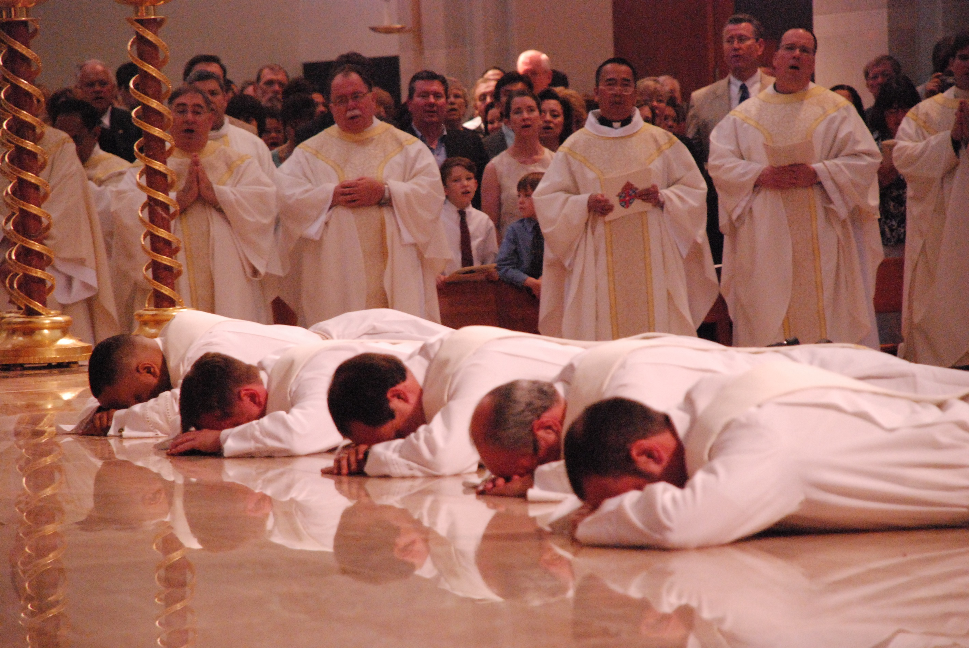

Slide 4
Days Fr. TJ has been a priest
3654 days

Slide 5
Or more simply
10 years

Slide 6
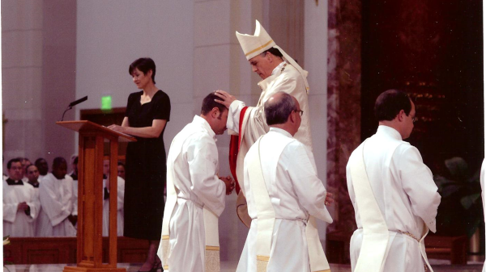

Slide 7
Fr. TJ’s Stats
Masses celebrated: 3168
Baptisms: 597
Weddings: 107
Hours in Confession:1397
Anointings of the sick: 956

Slide 8
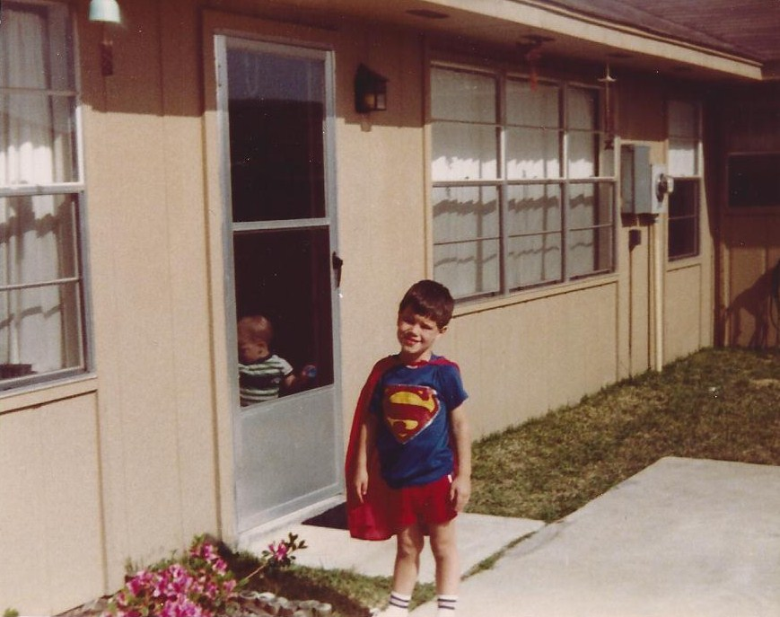

Slide 9


Slide 10
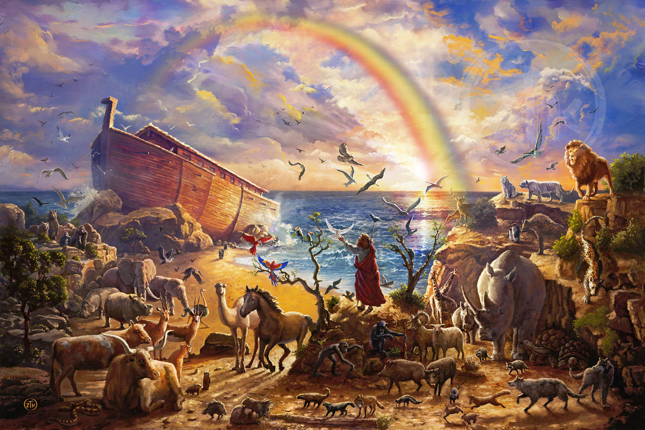

Slide 11
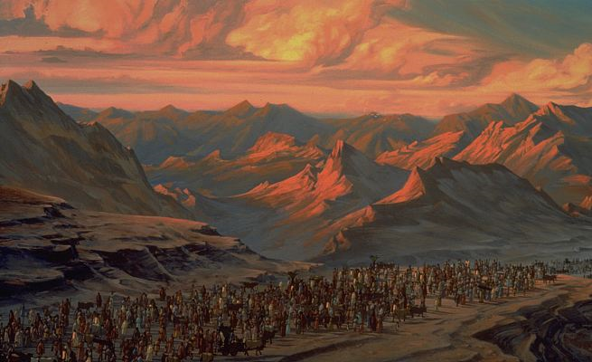

Slide 12
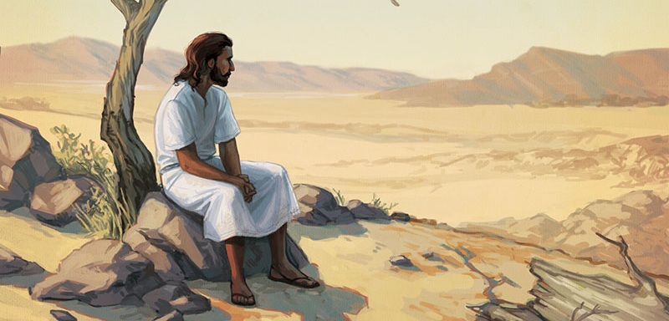

Slide 13
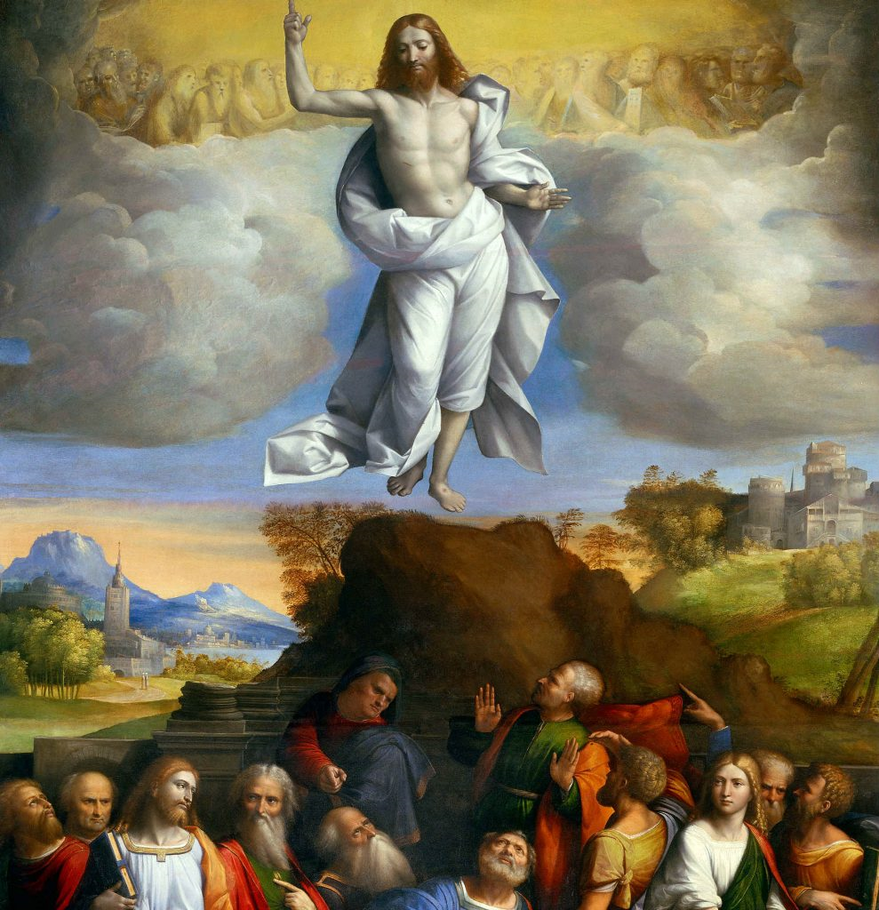

Slide 14
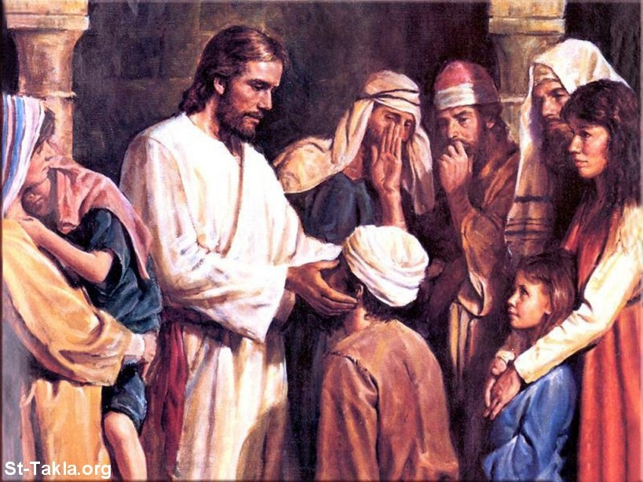

Slide 15
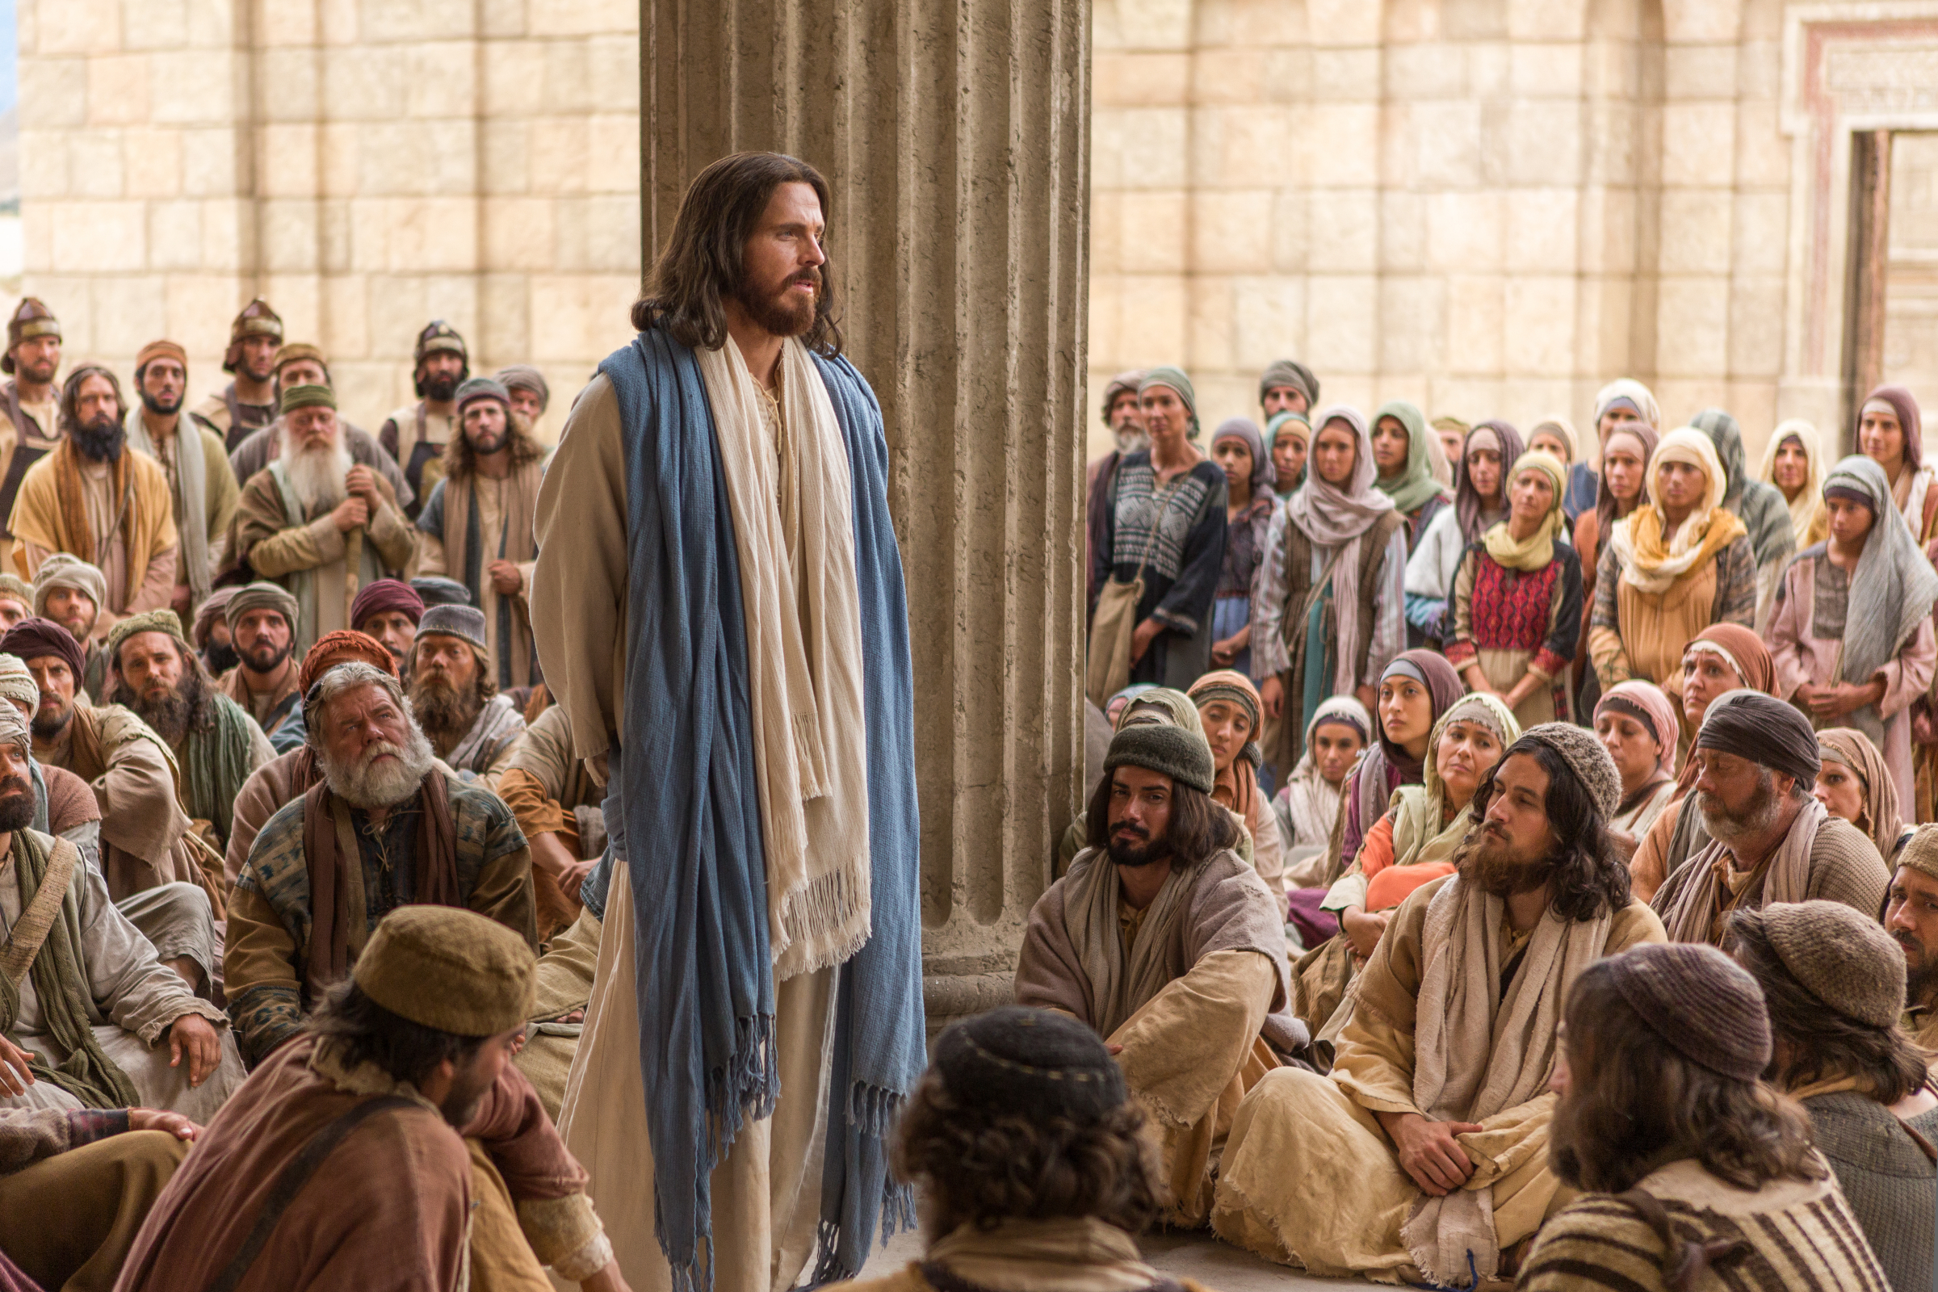

Slide 16
The Ascension teaches us:
1. We are called to share the good news!

Slide 17
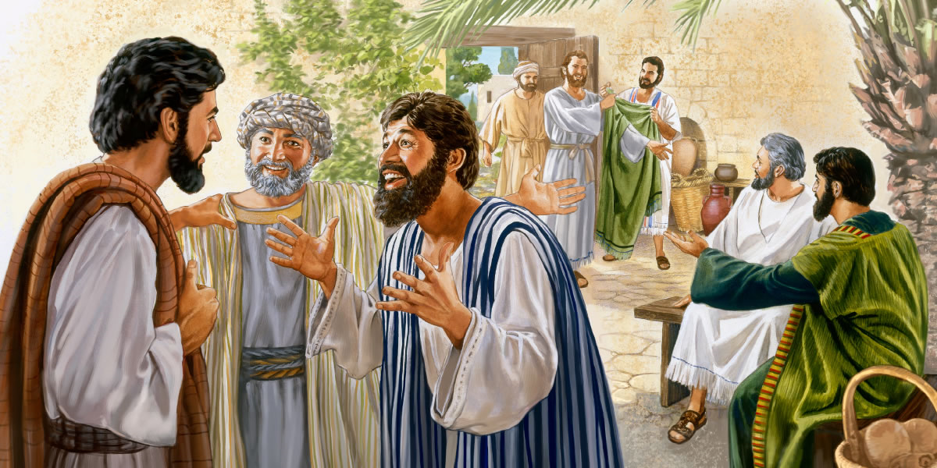

Slide 18
The Ascension teaches us:
2. We don’t know how long we are here on Earth

Slide 19
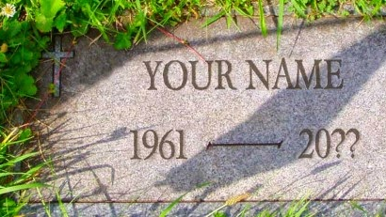

Slide 20


Slide 21
The Ascension teaches us:
3. Our true home is HEAVEN!

Slide 22
