Slide 1
Days Fr. TJ has been a priest
3408 days

Slide 2
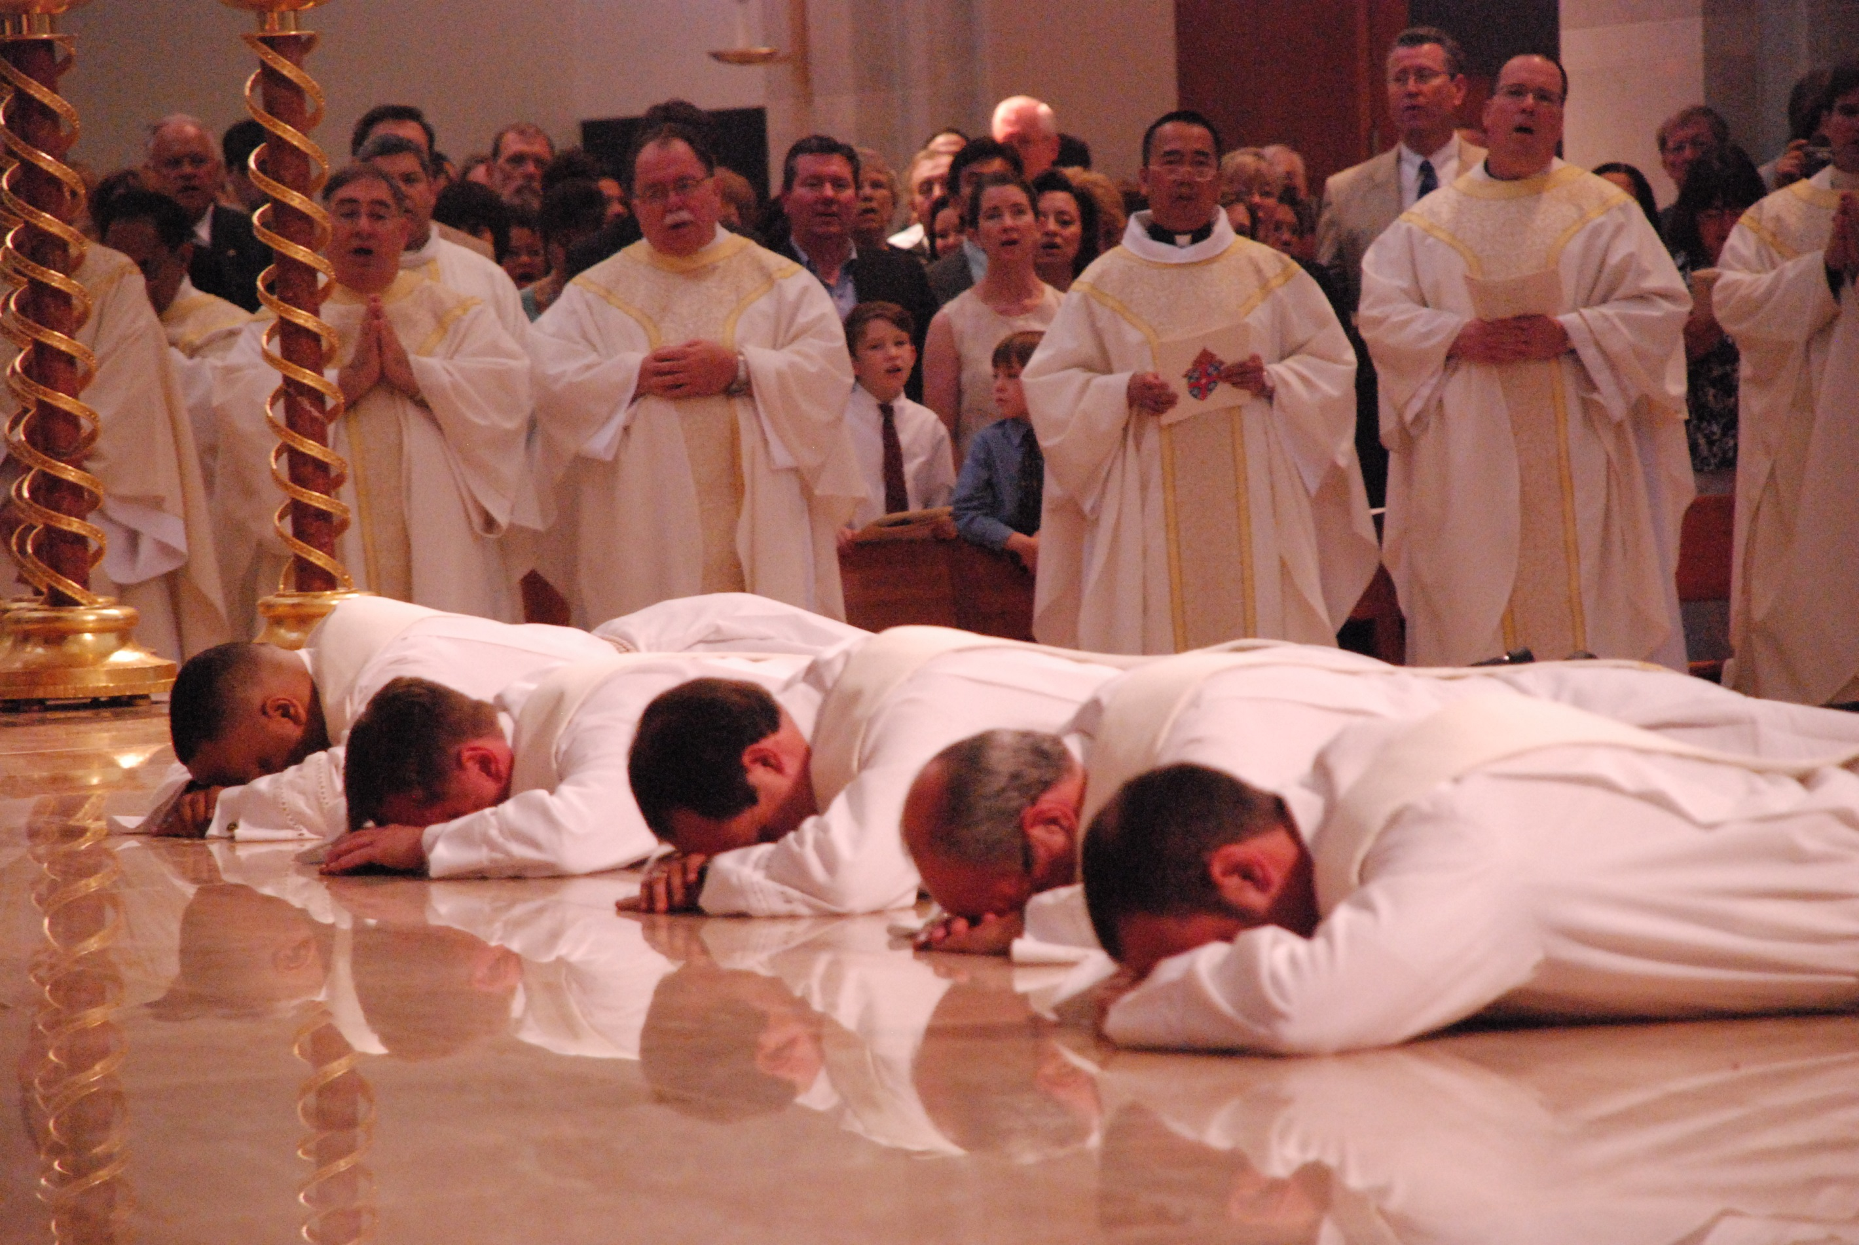

Slide 3
P: The Lord be with you.
R: And with your spirit.

Slide 4
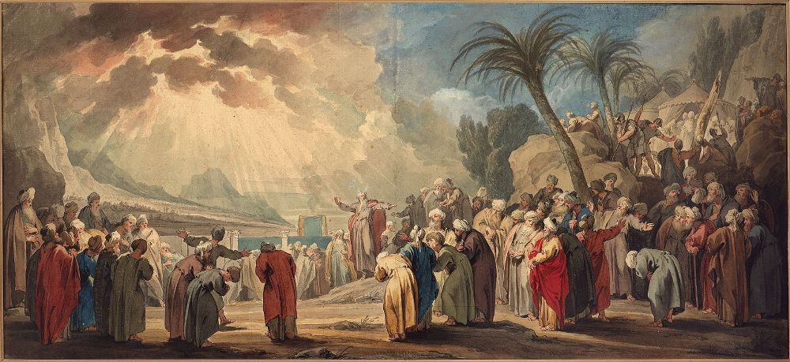

Slide 5
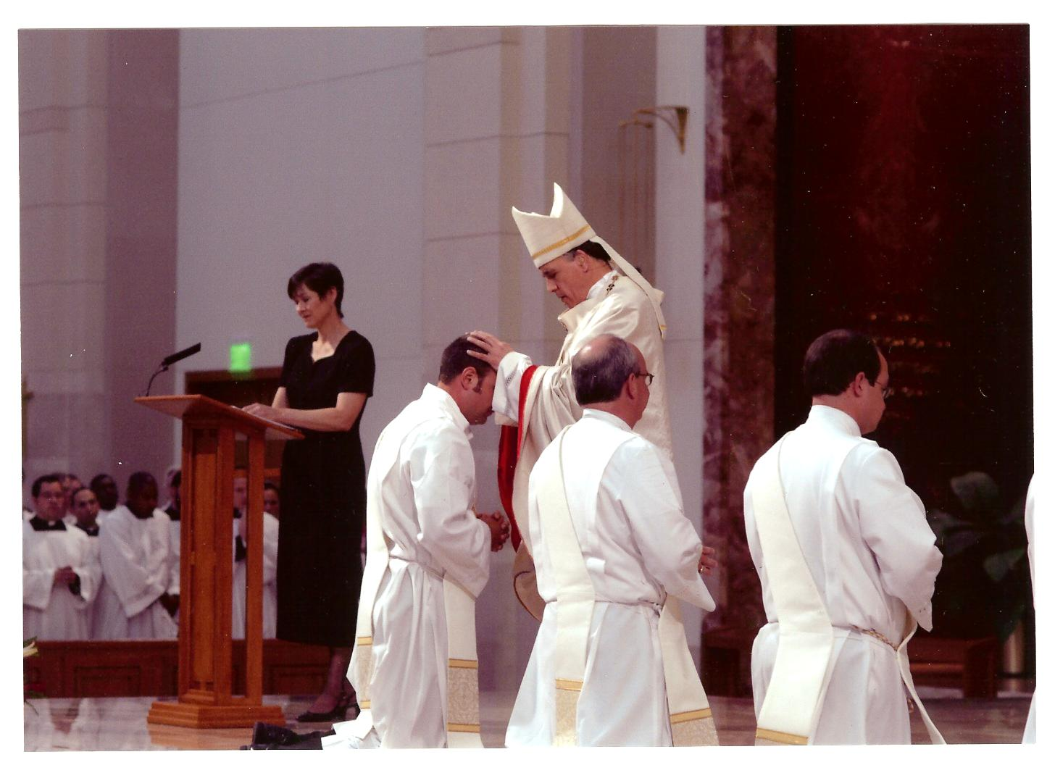

Slide 6


Slide 7


Slide 8
Budget REPORT
Can be found in the Bulletin

Slide 9
Increased expenses
Capital Campaign Ended
Cost of medical insurance increased, property Insurance increased, & Maintenance projects were higher

Slide 10
PARISH UPDATES

Slide 11
Woodland Hills Chapel
Blessed Sacrament is present: Chapel is a place of prayer

Slide 12
Communion Antiphon
Prayer of Scripture will replace “Sanctuary”

Slide 13
New
CHapel

Slide 14
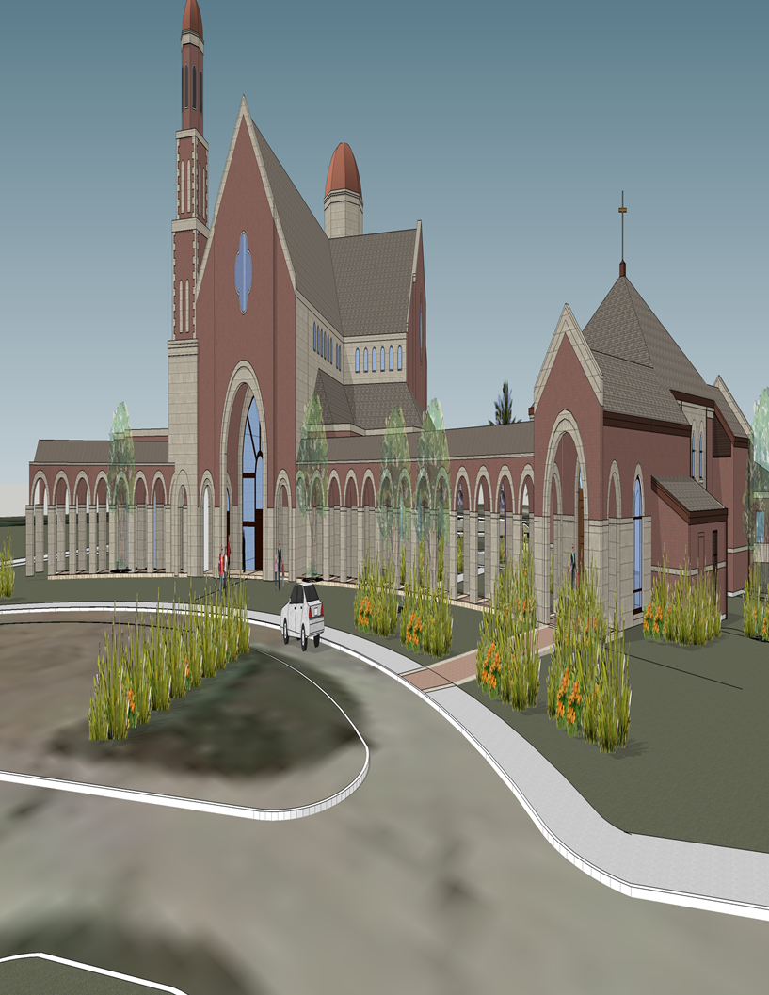

Slide 15
DEDICATION
Saturday, October 13th at noon
Will kick off our Fall Festival
Will be built by Summer 2019

Slide 16
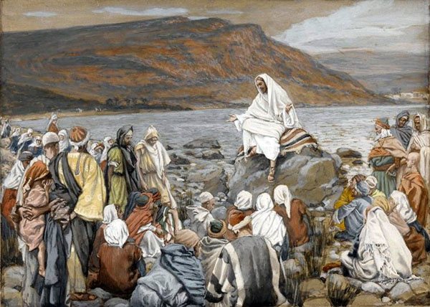

Slide 17
