Slide 1


Slide 2

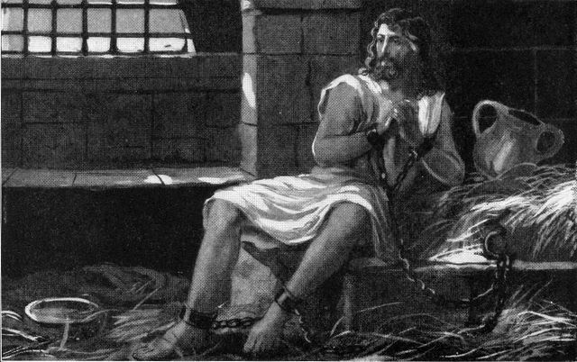

John the Baptist: Chillaxin in jail. All I did was stand up for God’s law. You can’t marry your sister in law, @KingHerod. Leviticus 18:16. #Lookitup

Slide 3
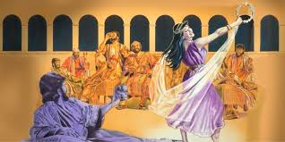


Salome Doing a little dance for my step-dad’s b-day! It was AMAZING!
Herod
Herodias THAT’S YOUR NIECE!!! AND YOUR STEP DAUGHTER!!!

Slide 4



Salome Step-dad said I could have anything I want. Any ideas?
Friend650 A diamond necklace!
Friend10032 $$$$$$$$$$
Herodias John the Baptist’s Head on a plate!
Friend650 Huh?!?! @Herodias

Slide 5
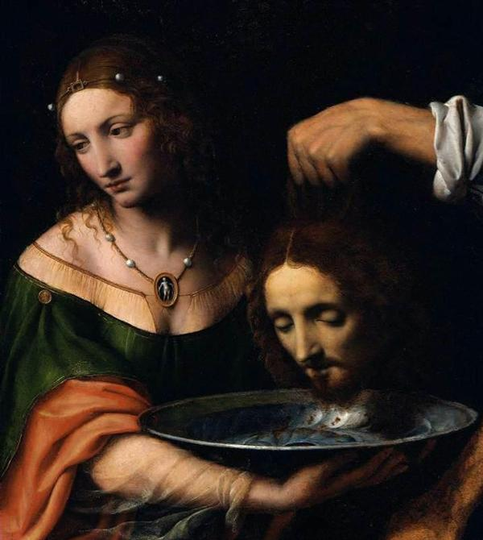
Salome I was creeped out by this today. Sorry @JohnBapist

Slide 6


Slide 7
Average Time Spent on Phone
162 Minutes

Slide 8


Slide 9


Slide 10



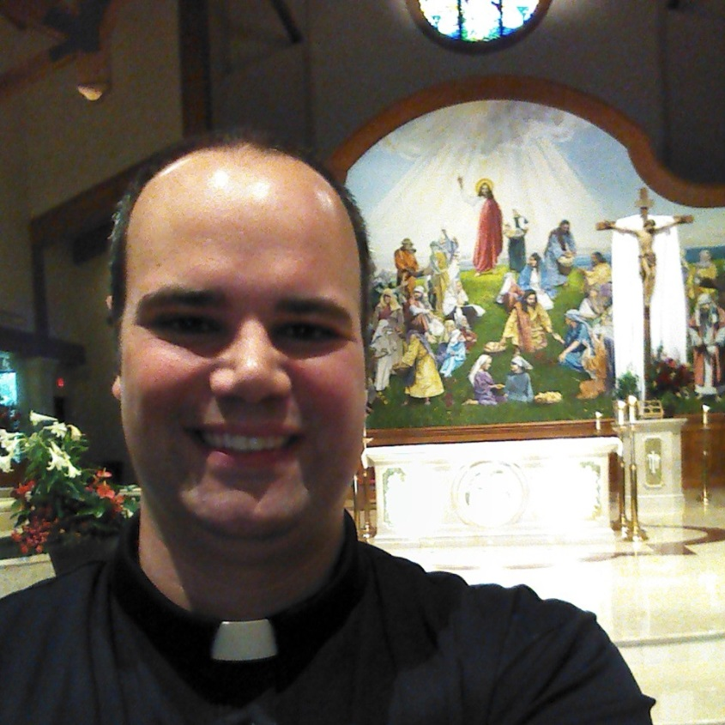

#tour_archgh

Slide 11
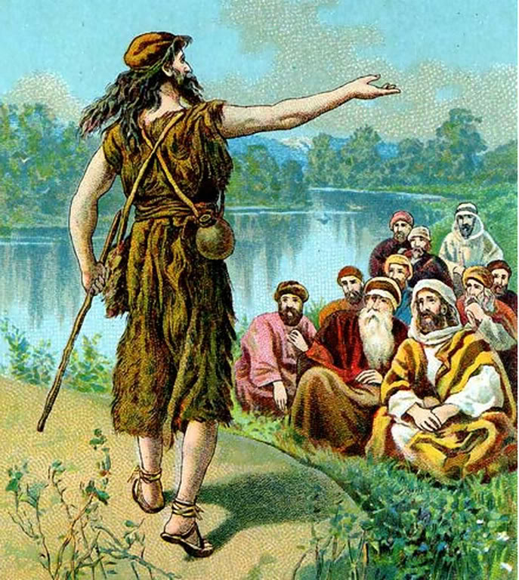

Slide 12


Slide 13


